Slide 1

Kung Faux Pandas: Simplifying privacy protection
Oral Presentations - Privacy and Bias in Data Science
S45
Seth Russell
University of Colorado Anschutz Medical Campus
Twitter: @magic__lantern
GitHub: magic-lantern;
Project URL: https://github.com/CUD2V/kungfauxpandas
#IS19
paper co-authors:
James King MIDS
Tellen D. Bennett, MD, MS
Debashis Ghosh, PhD
Notes:
Hi, I’m Seth Russell, today I’ll be talking about my group’s paper “Kung Faux Pandas: Simplifying privacy protection”

Slide 2
Disclosure
I and my co-authors have no relevant relationships with commercial interests to disclose.

Slide 3




Why Kung Faux Pandas?
https://github.com/CUD2V/kungfauxpandas
Notes:
The motivating factors behind Kung Faux Pandas are grounded in common tasks and problems encountered in biomedical research. Regardless of the type of research being performed, you will need a cohort of patients to evaluate.
<click to show cohort>
You want to access their data in a secure manner and protect their privacy
<click to show lock icon>
Through Institutional Review Boards, we have well established methods for getting protected health information to appropriate persons
<click to show arrows>

Slide 4



Why Kung Faux Pandas?
https://github.com/CUD2V/kungfauxpandas
Notes:
Once your research is done, you throw a party
<click to show paper icon>
Then you have to really get to work and share your results.
In addition to the purpose of publishing your work to show your value to the informatics community and your employer or grant agency, <click to show next slide>

Slide 5
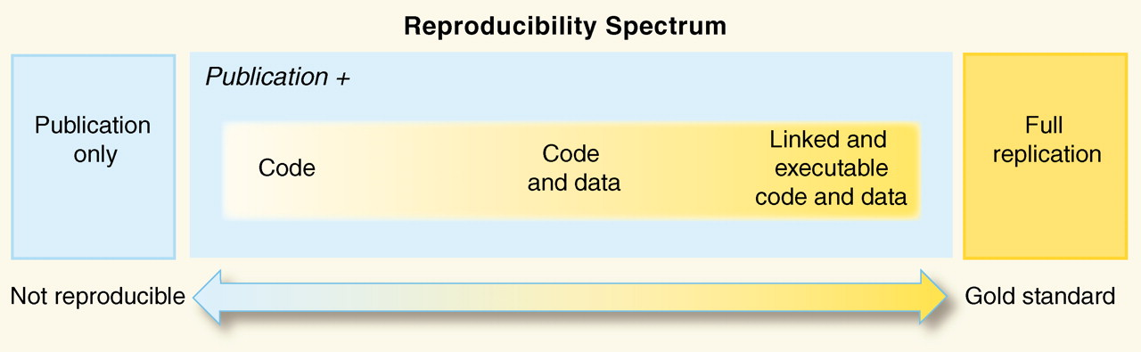
Reproducibility and Replicability
No PHI Zone
Peng RD. Reproducible research in computational science. Science (New York, Ny). 2011 Dec;334(6060):1226– 1227. Available from: https://www.ncbi.nlm.nih.gov/pmc/articles/PMC3383002/
https://github.com/CUD2V/kungfauxpandas
Notes:
We all hope that the research we do makes a difference in the lives of individuals. The path to making a difference lies in others reproducing and replicating our results to form scientific consensus. As shown in this diagram from Roger Peng there is a continuum between replication and non–replication. In order to move toward an ideal gold standard of full replication and reproducibility, data is a critical element. However, as is the case for most of us, we work with protected health data.
In order to protect the privacy of individuals, we cannot share
<click to show no-phi>
the actual data that we used to achieve our results. So, the diagram has to be amended to remove the data sharing portion. We are sadly left with not achieving the gold standard of full replication.
In most cases, the best we can do is share our code and some summary statistics that prevent full replication.
<next slide>

Slide 6
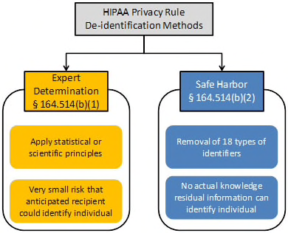
Reproducibility and Replicability
https://www.hhs.gov/hipaa/for-professionals/privacy/special-topics/de-identification/index.html
https://github.com/CUD2V/kungfauxpandas
Notes:
Under HIPAA Privacy Rule, we have 2 options for de-identification; however, many health care organizations are highly risk averse and prefer to not release even de-identified data due to re-identification risks and legal fears.
<next slide>

Slide 7

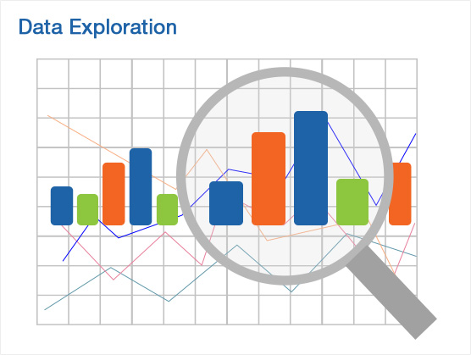
Why Kung Faux Pandas?
Privacy protection through data synthesis
https://github.com/CUD2V/kungfauxpandas
Notes:
The Kung Faux Pandas tool that we developed, abbreviated as K-F-P hereafter, is aimed at helping to solve the data sharing problem. As a quick explanation for the name: Faux is in reference to artificial, similar to how faux fur or faux leather is used in place of real animal derived materials. We based our tool around the Python Pandas data science library. And lastly, we added the term Kung just because it sounded cool with faux and pandas.
In addition to data sharing for replication purposes,
<click to show data exploration image>
it can also be used for initial data exploration (such as before IRB approval) or in learning situations – getting students real enough data for them to learn how to do research without endangering privacy.
Here are some of the unique contributions that KFP makes:
<click to show mountain>
There’s a mountain of data out there, getting around it and understanding it is complicated. Our tool can be used as a self-service data synthesis tool. Our tool can put a smile on your face as you can begin exploring a synthetic version of data for preliminary results before going through the full PHI approval process.
Additionally, No configuration is required; though users can configure synthesis parameters if desired.

Slide 8
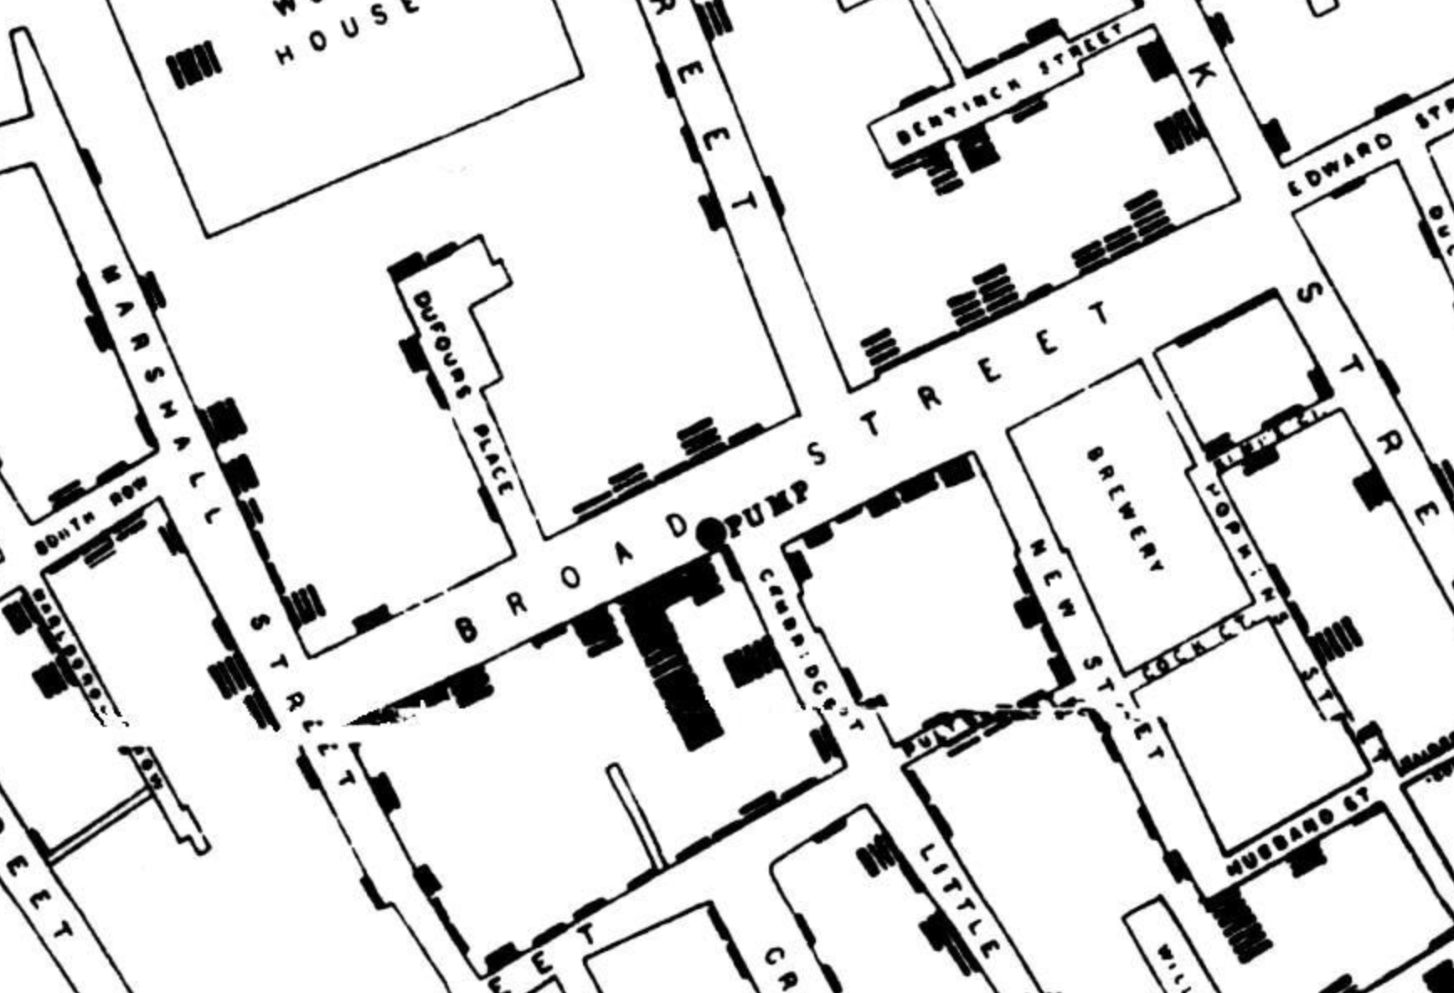

Why Kung Faux Pandas?
Privacy protection through data synthesis
https://github.com/CUD2V/kungfauxpandas
Notes:
KFP allows for the modular combination of privacy protection methods. We have implemented 2 different synthetic data methods; adding new methods is also supported
<click>
Lastly, we give you the maps and plans to build on our work – we have made available source code, multiple methods for using our software, and unit tests.

Slide 9
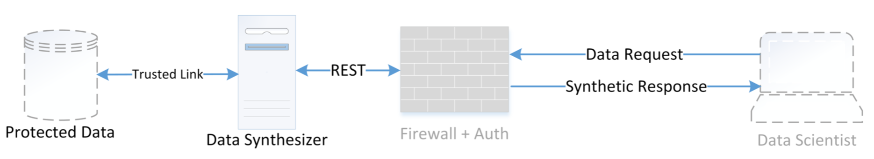
KFP System Architecture Part 1
https://github.com/CUD2V/kungfauxpandas
Notes:
As an overview of how KFP works, here is a high level diagram.
Normally, a data scientist or other computational researcher would need special permission to access protected data. By providing an intermediary, similar to an honest broker used in health information exchanges, a researcher can access synthesized data in an ad-hoc and exploratory manner without needing to see the actual source data.

Slide 10
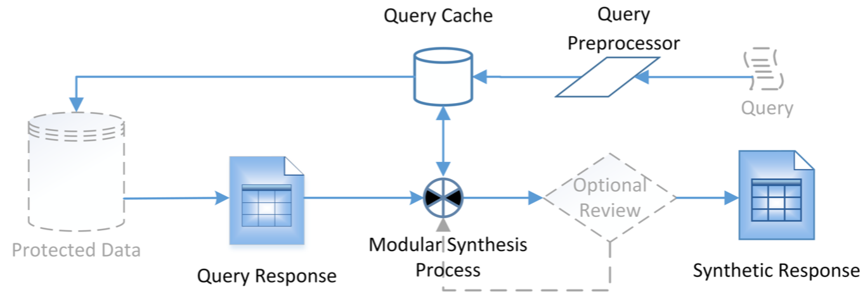
KFP System Architecture Part 2
https://github.com/CUD2V/kungfauxpandas
Notes:
Now, let’s take a more detailed look at the architecture. A user submits a query to our system which is pre-processed to remove invalid SQL commands such as delete, insert, update. Next the query is logged to record what query was submitted. The processed query is then executed against the protected data source and then the query response is handed off to our synthesis process. Users can select the synthesis method desired and then they only receive the synthetic response back from the synthesis process.

Slide 11
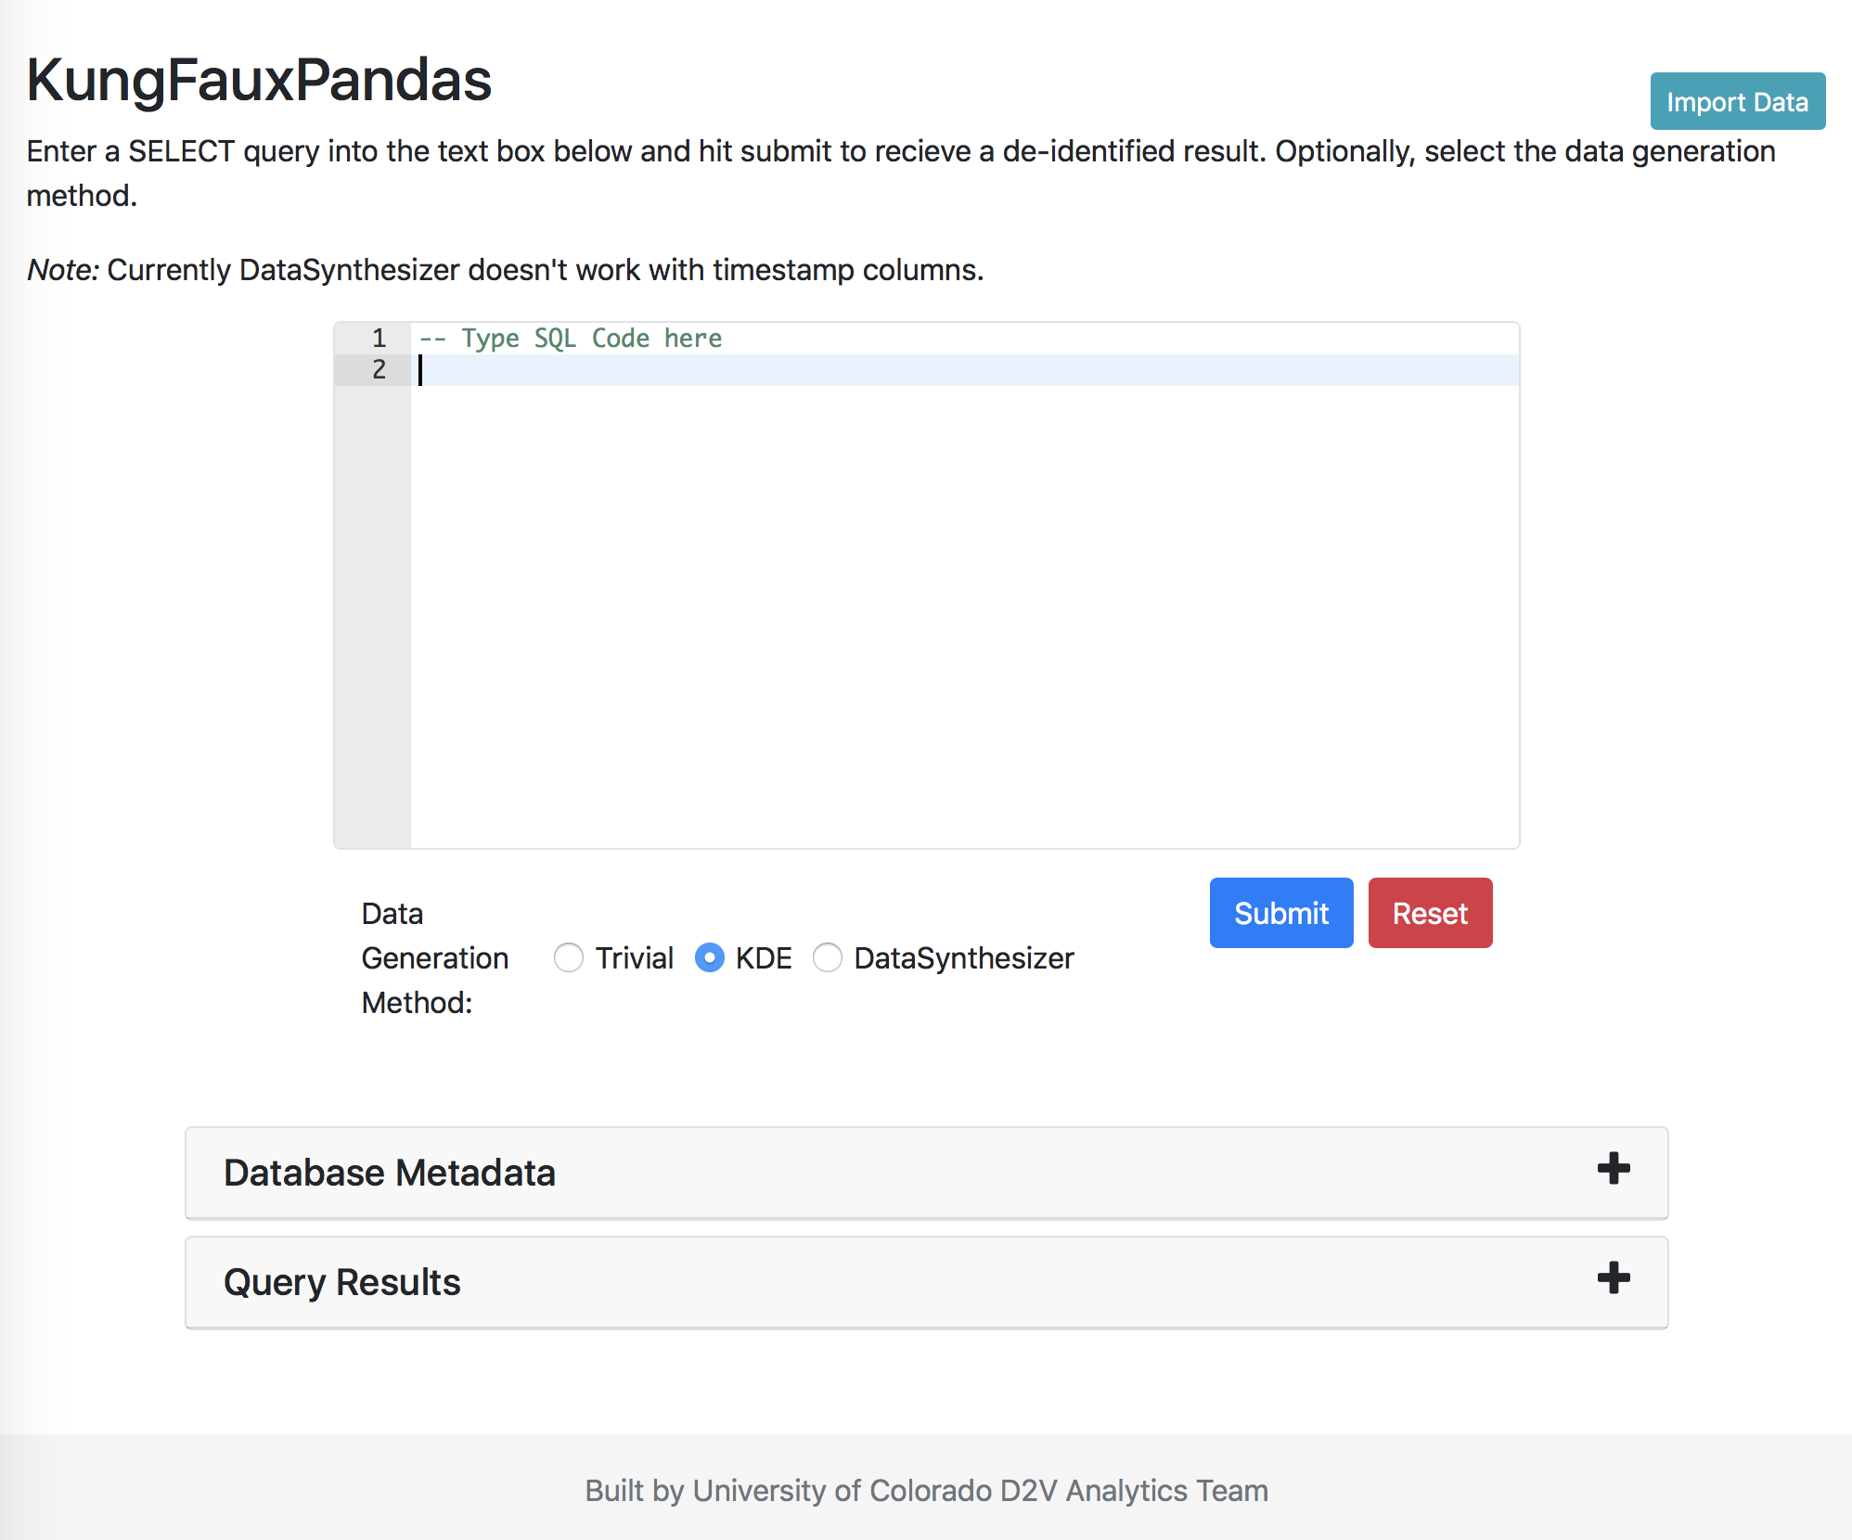
Provided Interfaces
HTML/JS UI
REST API
Python API
HTTP GET http://localhost:8000/synthesize_data?query=...
https://github.com/CUD2V/kungfauxpandas
Notes:
To make using this tool easier, we’ve provided multiple methods for using Kung Faux Pandas.
We have a web based user interface <click>
that allows users to enter SQL queries and get results in a near real-time fashion as if they were working directly with the original data source.
<click>
A Representational State Transfer aka REST API that allows for easy extension or inclusion into other products regardless of language or platform
<click>
And lastly, the native python classes

Slide 12
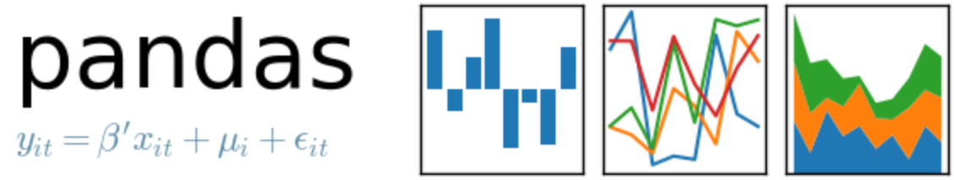
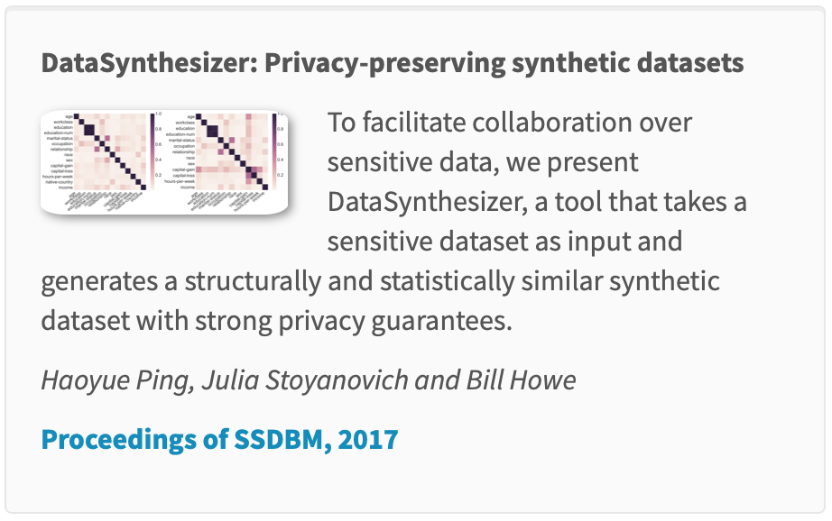

Included Synthesis Methods
scipy.stats.gaussian_kde
https://github.com/CUD2V/kungfauxpandas
Notes:
We have leveraged the Python Pandas library to create an extensible system.
Our system allows for multiple synthesis methods – and is open for extension of additional methods.
We currently have implemented two data synthesis methods -
<click>
one from the Scipy python library
<click>
and one from DataSynthesizer - the group has several papers and as shown here includes Ping, Stoyanovich and Howe

Slide 13
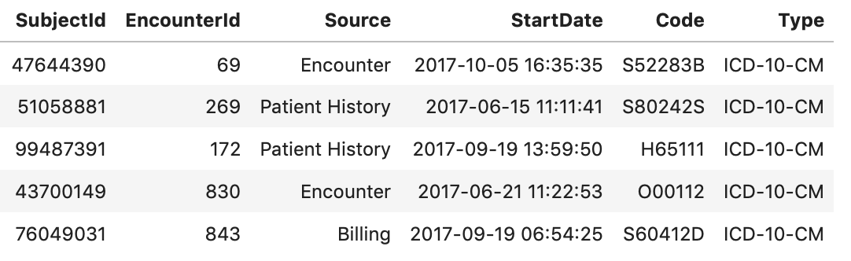
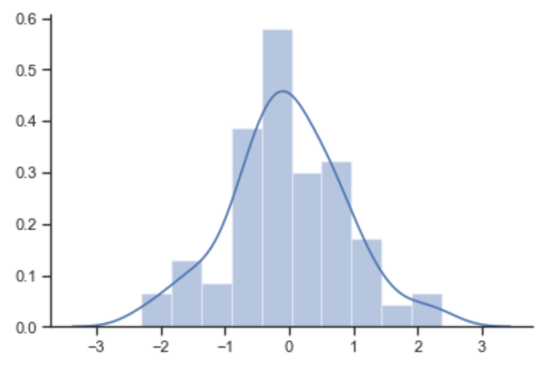
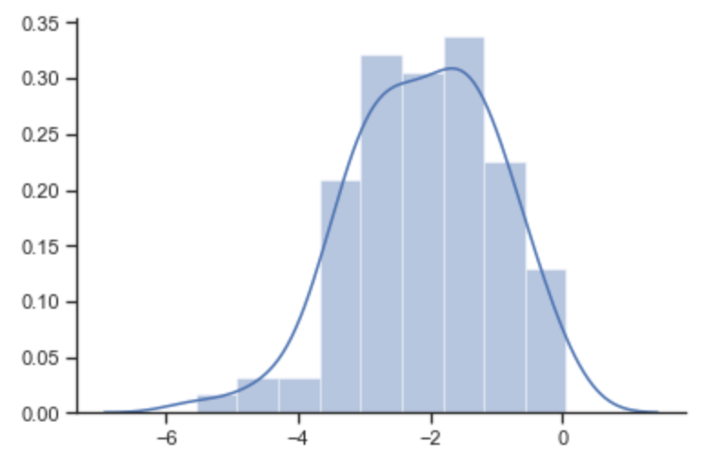
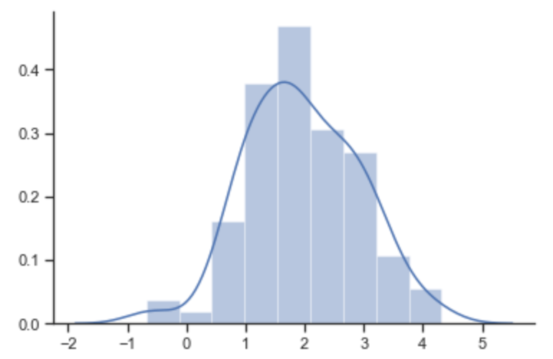
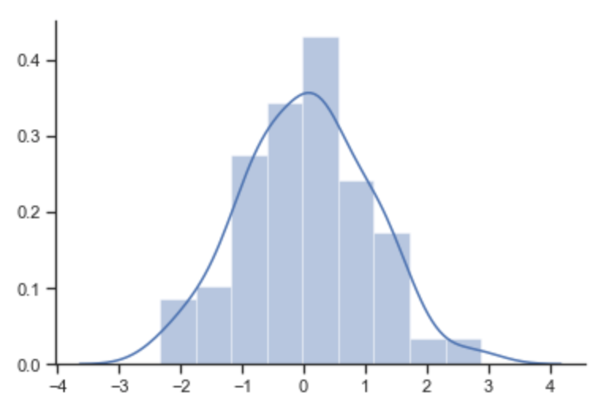
Included Synthesis Methods
Independent Attribute Mode
https://github.com/CUD2V/kungfauxpandas
Notes:
Each of the data synthesis methods have two modes. The first mode is an independent attribute mode. As an example,
<click>
suppose you have the data set shown here. Each variable in the dataset are represented as columns. Specific observations are rows. Independent attribute mode analyzes each variable independently and a distribution function is generated for each variable.
<click to show highlight for subject id> One for Subject ID
<click to show highlight for encounter id> One distribution for Encounter ID
<click to show highlight for source id> One distribution for Source
Thus each variable per sample is generated independently of all other variables.
<click to show rest>

Slide 14
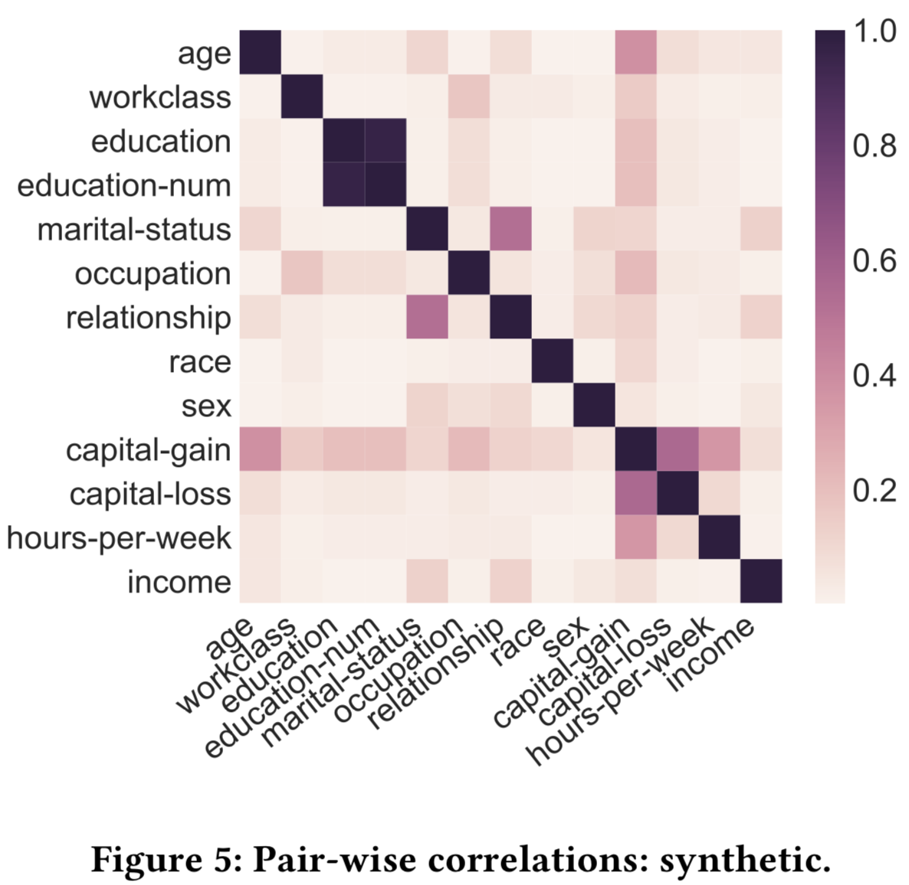
Included Synthesis Methods
Correlated Attribute Mode
“DataSynthesizer: Privacy-Preserving Synthetic Datasets”
https://dl.acm.org/citation.cfm?doid=3085504.3091117
https://github.com/CUD2V/kungfauxpandas
Notes:
The other method called correlated attribute mode is built on the correlation structure between attributes as illustrated by this image from one of the DataSynthesizer papers. Each variable is modeled in context of the other variables and when generating synthetic data, the inter-relationship between variables is preserved as much as possible.

Slide 15
Performance of Synthesis Methods
Time to analyze and synthesize 100,000 rows
Method | Seconds
Kernel Density Estimator Independent | 0.1
Kernel Density Estimator Correlated | 120.0
DataSynthesizer Independent | 2.6
DataSynthesizer Correlated | 160.0
DataSynthesizer Correlated/custom config | 2124.0
sourcecode/python/notebooks/performance_tests.ipynb
https://github.com/CUD2V/kungfauxpandas
Notes:
Fast generation of synthetic data is important in a self-service setting where researchers can generate their own faux data as needed.
In our timing tests for data synthesis, some methods perform much faster than others.
The KDE plugin is a simple method, and quickly generates data
<click>
that looks similar to the input data and works well for the range of data types. When modeling the inter-relationship between variables,
<click>
there is significant overhead in terms of time to generate synthetic data.
<click>
DataSynthesizer in ”correlated” mode builds a Bayesian network which is very good at generating realistic data, but as shown here it takes significantly longer than the more basic independent attribute mode.
<click>
When providing custom configuration the complexity of the Bayesian network can increase significantly, greatly adding to the time to generate the synthetic data.
<click>
In all cases, synthetic data generation is a CPU intensive task; no parallelization has been implemented by either KFP nor the plugins used. While memory usage does increase as data size increases, at the 100,000 rows seen here, memory usage peaked at around 4.7GB for the Python process.

Slide 16
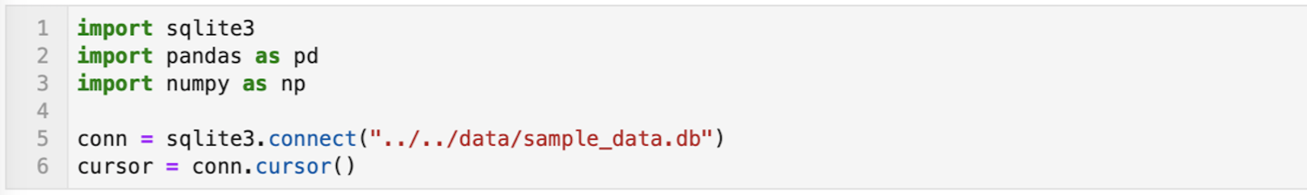
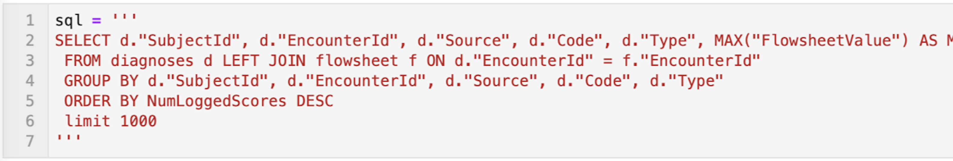
Python Pandas compatible API
KFP Setup (sourcecode/python/notebooks/presentation_example.ipynb)
https://github.com/CUD2V/kungfauxpandas
Notes:
Here is an example of how to use our library in python.
<click>
This code block shows the basic setup steps required to use our library. First you need to import a few standard python libraries depending on your use case,
<click> then our library,
and lastly
<click>
writing your sql query. KFP can also generate synthetic data from an existing Pandas Dataframe.

Slide 17
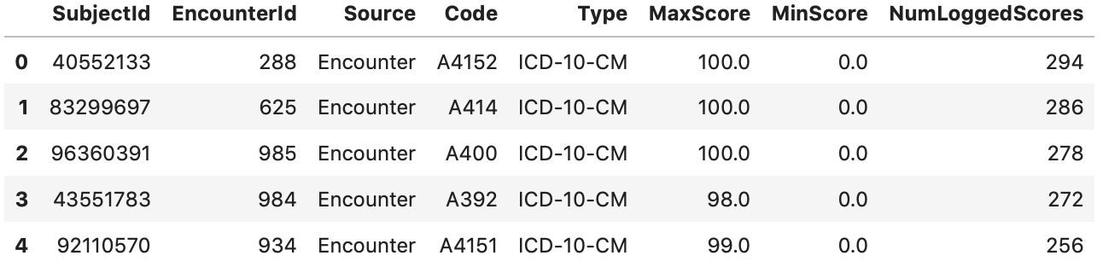
Python Pandas compatible API
https://github.com/CUD2V/kungfauxpandas
Notes:
If run directly, the SQL shown previously results in this data set. There are identifiers, floating point values, integer values and some categorical variables

Slide 18
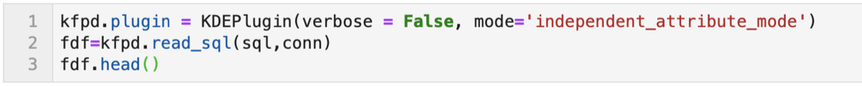
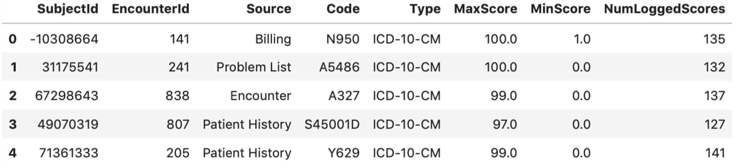
Python Pandas compatible API
https://github.com/CUD2V/kungfauxpandas
Notes:
To generate synthetic data, call our overridden read_sql pandas method on your instance of the selected plugin – in this case the Kernel Density Estimator plugin
<click>
The data at the bottom of this slide is the synthesized dataset. Note most columns appear very similar to the source – ICD-10-CM codes are real, scores appear similar to real data.
<click to show box around subjectID>
Except for the subjectID where you can see the first patient has a negative ID.

Slide 19
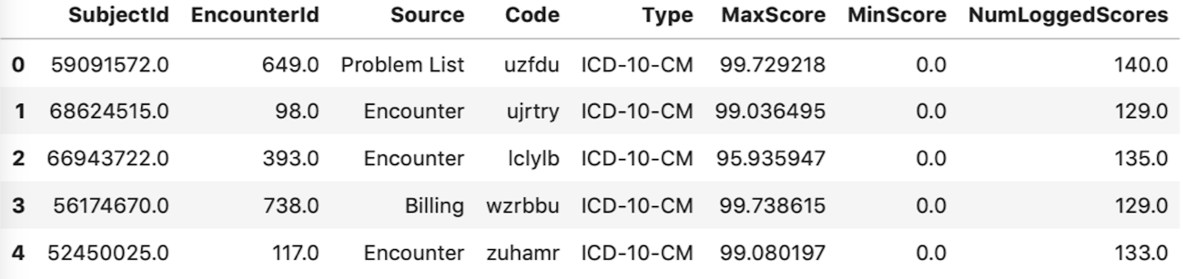
Python Pandas compatible API
https://github.com/CUD2V/kungfauxpandas
Notes:
Here’s an example of how to generate data using the DataSynthesizer plugin. The only difference is calling read_sql from the context of a different plugin object.
<click>
Here is the resulting data set from the DataSynthesizer plugin. Note that in most cases, data appears similar to the real data shown earlier.
<click to show box around problem>
Note in this case the ICD-10-CM code column is just random letters. With the default configuration for this plugin, some columns result in random strings of letters rather than allowed values.

Slide 20
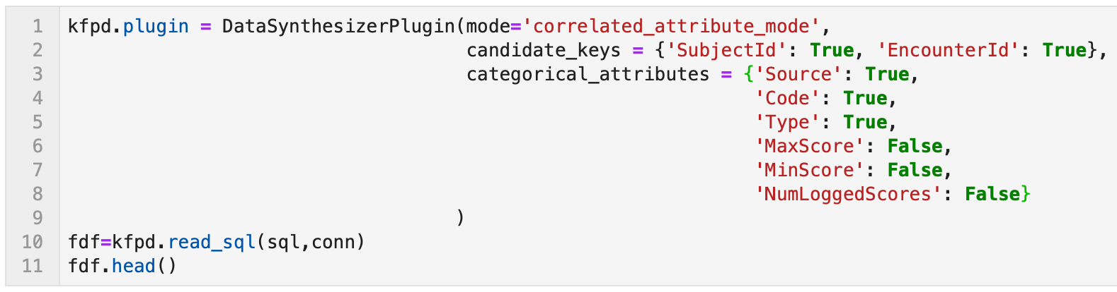
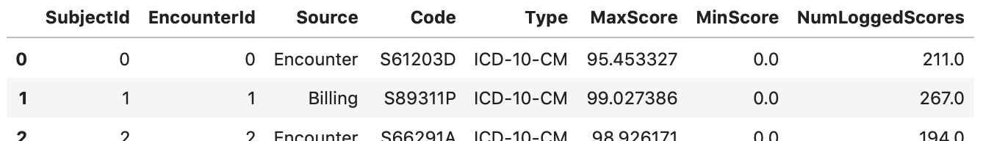
Python Pandas compatible API
https://github.com/CUD2V/kungfauxpandas
Notes:
With more advanced user specified configuration as shown in this code block, the data generated
<click>
more closely matches the input data set.
<click to highlight ID columns>
IDs are now sequentially generated.
<click to highlight Code column>
The ICD-10-CM column has actual ICD10 codes.

Slide 21
Reproducibility and Replicability
Peng RD. Reproducible research in computational science. Science (New York, Ny). 2011 Dec;334(6060):1226– 1227. Available from: https://www.ncbi.nlm.nih.gov/pmc/articles/PMC3383002/
https://github.com/CUD2V/kungfauxpandas
Notes:
As our tool is designed to aid in data sharing and reproducibility, we have put effort into making our research more reproducible and replicable. On the spectrum shown previously, we have tried to be toward the gold standard end of the reproducibility spectrum

Slide 22
Reproducibility and Replicability
What have we done to promote reuse and reusability?
Software, documentation, paper, this presentation, etc. available at: https://github.com/CUD2V/kungfauxpandas
Docker Container: docker pull blackspot/synthesis
Unit tested software using https://pytest.org
https://github.com/CUD2V/kungfauxpandas
Notes:
Here are some of the items we have done to make KFP reproducible and replicable:
<click>
Our public github repository has guides on how to use this software as well as our source code, version history, and other items including this presentation.
<click>
We have provided our software and sample data available as a docker container: Docker is a light weight virtualization technology that allows people to share code in a fully encapsulated environment so others can run that code without installation dependencies (other than having Docker installed).
<click>
Lastly, we have united tested our software and have used it to verify correct behavior during implementation as well as catch problems due to dependency updates.

Slide 23
Limitations
Generates synthetic data only when given a specific SQL query or pandas.DataFrame
Performance
Get legal advice before releasing any data generated by KFP
Provided web application does not include SSL certificates, so data is not encrypted
https://github.com/CUD2V/kungfauxpandas
Notes:
Of course, our software is not going to solve all your research problems. Here are some limitations:
<click>
KFP does not generate an entire EHR. It will only generate synthetic data based on an input SQL query or Pandas Data Frame.
<click>
I have shown some timings for synthetic data generation. KFP may not be performant enough if source data sets are too large. As I mentioned previously, we have not implemented any parallelization. One idea for improvement here could be to create a parallel stochastic synthesis process.
<click>
While we believe our tool protects privacy through data synthesis, be sure to get appropriate legal review and approval before using this tool to release synthetic data to the general public.
<click>
Ensuring proper encryption between components that have access to actual Protected Health Information is left as an exercise for the implementer.

Slide 24
Areas for Further Research
Additional plugins.
Approval and review of results before returning to end user.
More specific controls – for example minimum input and output sizes
Develop metrics for privacy guarantees (differential privacy, plausible deniability, etc.)
Publish code as python package
Others based on feedback from users
https://github.com/CUD2V/kungfauxpandas
Notes:
Now that you know some of the limitations of KFP, here are some areas that we plan to develop further:
<click>
one obvious area would be to develop plugins for additional faux data methods. Hopefully some of you can help contribute to that process!
<click>
We have not addressed institutional specific privacy issues such as a review and approval flow
<click>
In this work, no attempt has been made to constrain data set sizes. As an example, KFP could be modified to return no results if a minimum threshold is not met or, alternatively, data boosting techniques in combination with synthesis could be used based on the risk profile of the data owner(s).
<click>
Use existing privacy measurements such as differential privacy to create metrics to accompany a synthetic data set
<click>
Make code available as python package installable via pip or conda
<click>
The last area recommended for further research is to deploy and observe the use of KFP in an active environment where researchers are working with sensitive datasets and see what others identify as feature gaps.

Slide 25
Thank you!
Notes:
Thank you for your time. If anyone would like a copy of the Kung Faux Pandas paper to read, I have several copies to hand out.

Slide 26
Image credits
https://www.behance.net/gallery/5408155/Family-Icon
https://www.freepik.com/free-vector/scientist-decorative-icons-set_2871430.htm
https://www.vectorstock.com/royalty-free-vector/doctor-icon-medical-consultation-female-physician-vector-18769418
https://www.flaticon.com/free-icon/lock-icon_26053
https://cdn3.iconfinder.com/data/icons/wedding-4/512/clink-512.png
https://cdn.iconscout.com/icon/free/png-256/balloon-decoration-christmas-xmas-celebration-party-30627.png
https://cdn2.iconfinder.com/data/icons/communication-2/512/Pencil_And_Paper-512.png
https://s3-ap-south-1.amazonaws.com/av-blog-media/wp-content/uploads/2018/07/Data-Exploration.jpg
https://github.com/CUD2V/kungfauxpandas

Slide 27
Items to include?
Independent reproduction and replication of results are critical components of scientific research. Barriers to data access and data sharing are some of the most important impediments to reproducibility in health data science research. Health care organizations are often reluctant to share data even when it has been de-identified. Through data synthesis, fears about data sharing can be reduced. Through providing ad-hoc synthetic data, health data scientists can have lower barriers to accessing private data as well as reduced barriers to sharing artificial data derived from protected data
Reproducibility: the "ability to recompute data analytic results given an observed dataset and knowledge of the data analysis pipeline,"
Replicability: "the chance that an independent experiment targeting the same scientific question will produce a consistent result."
https://github.com/CUD2V/kungfauxpandas

Slide 28
[Your Presentation]
[Your presentation on this and next slides]
https://github.com/CUD2V/kungfauxpandas

